Slide 1



Ethics in IT
Class VIII
lab 3

Slide 2


Ethical Hacker
Hacker who
protects hacker

Slide 3

Purpose of Ethical Hacking
evaluate the
security and identify
vulnerabilities in systems

Slide 4
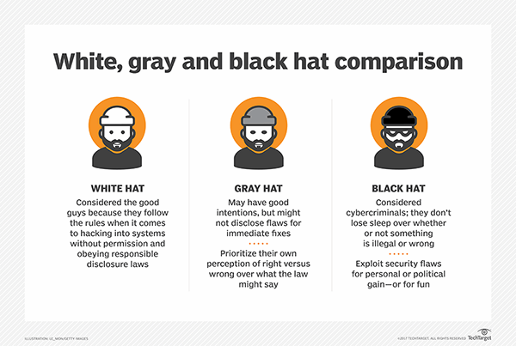
Comparison of Hackers

Slide 5
Ethical Hacking Techniques
Scanning ports to find vulnerabilities. Ethical hackers use port scanning tools, such as Nmap, Nessus or Wireshark, to scan a company's systems, identify open ports, study the vulnerabilities of each port and take remedial action

Slide 6

Become an Ethical Hacker
There are no standard education criteria for an ethical hacker, so an organization can set its own requirements for that position.

Slide 7
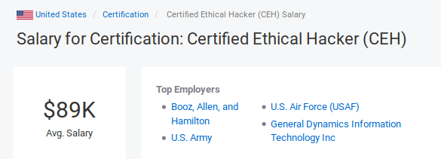
Certified Ethical Hacker
CEH takes exam to ensure a ethical hackers quality and skills.
This certification covers more than 270 attacks technologies.

Slide 8



